Slide 1
SIGNCOMPANION
(FACILITATOR FOR COMMUNICATION WITH HEARING IMPAIRED PEOPLE)
Satyendra Singh
MSc Data Science and Analytics
Notes:
Entered text
SignCompanion a backend program that will facilitate the communication between the normal people and hearing impaired people. Though we know that their are almost 1% arround the world , approximate1% india , of total population are deaf. There are hearing support devices present in the market but not everyone can afford them. SignCompanion can be used as a link between both as it is a bi- directional that supports communication in both ways. It take text or speech input and transform it into sign language video using python programming. It takes sign language hand gesture and predict the alphabet character with help of Random classifier which is trained previously on sign language images data , and then based on predicted character it suggest common words or sentence that may a person wants to tell.

Slide 2
SignCompanion: Bridging Communication Gap Between Normal and Hearing Impaired People
A bi-directional backend program aimed at facilitating communication between normal people and hearing impaired individuals by transforming text or speech input into sign language video using Python programming And Predicting with suggestion ,sign language hand gestures using machine learning model.

Slide 3
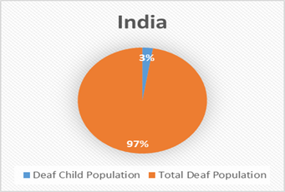
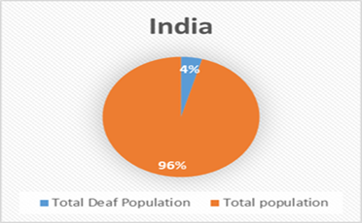
Introduction
·
SignCompanion is a program that bridges the communication gap between normal people and hearing impaired individuals.
In India Total Hearing Impaired/Deaf Population -63 M / 1.39 B
In India Total Child Hearing Impaired/child Deaf Population -1.7 M / 63 M.
Not everyone can afford hearing support devices available in the market.

Slide 4

Bi-Directional Communication
SignCompanion supports bi-directional communication in both ways.
It accepts text or speech input and transforms it into sign language video using Python programming.
And It read sign language hand gestures to predict english alphabets & digits.

Slide 5
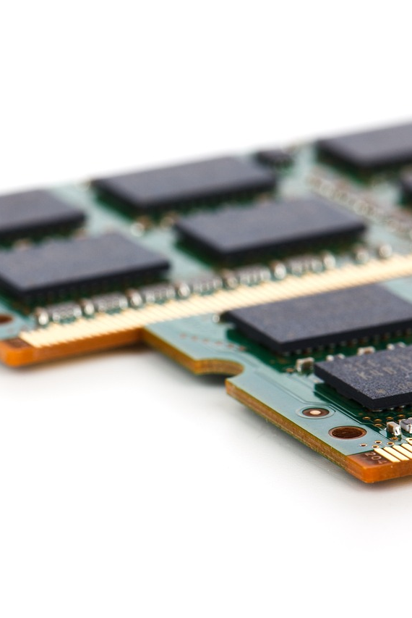
Transformation of Input
SignCompanion transforms text or speech input into sign language video.
It uses a Random Forest classifier trained on sign language images data to predict the alphabet character based on sign language hand gesture and suggest communication words that can be possibly a person wants to convey.

Slide 6
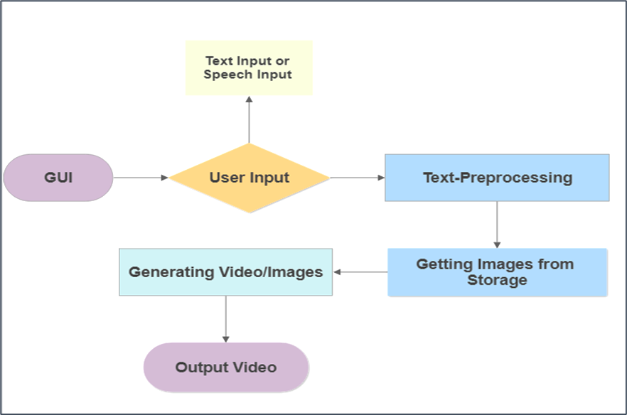
Text or Speech to Sign Language Conversion

Slide 7
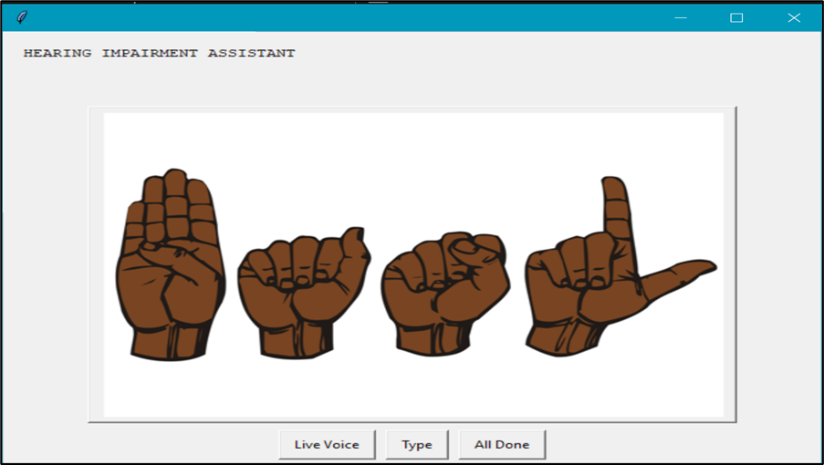
.

Slide 8
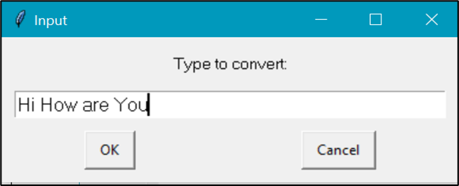
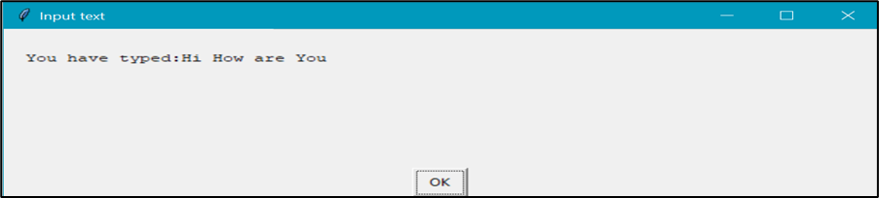
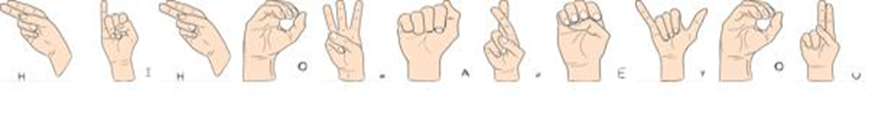
.

Slide 9
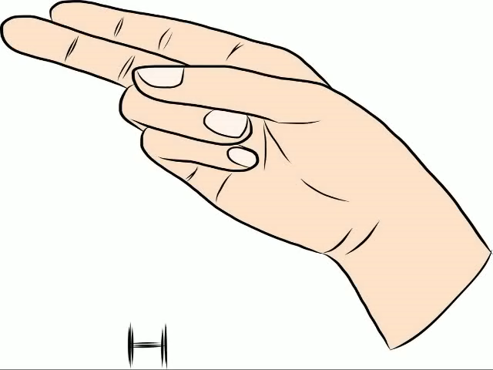
OUTPUT VIDEO

Slide 10
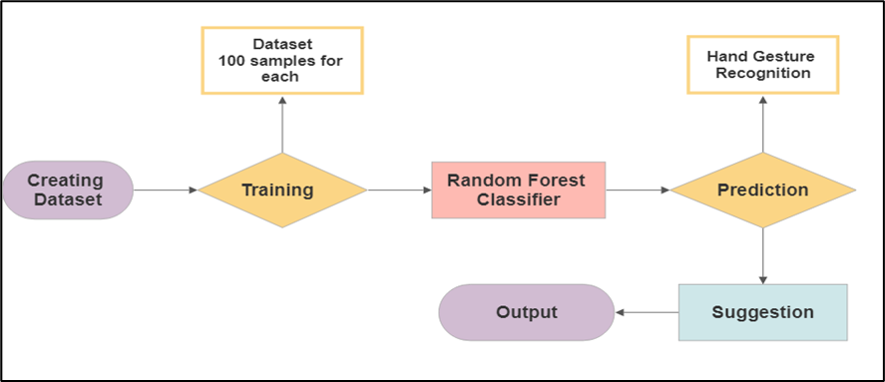
Sign Language to text Detection

Slide 11
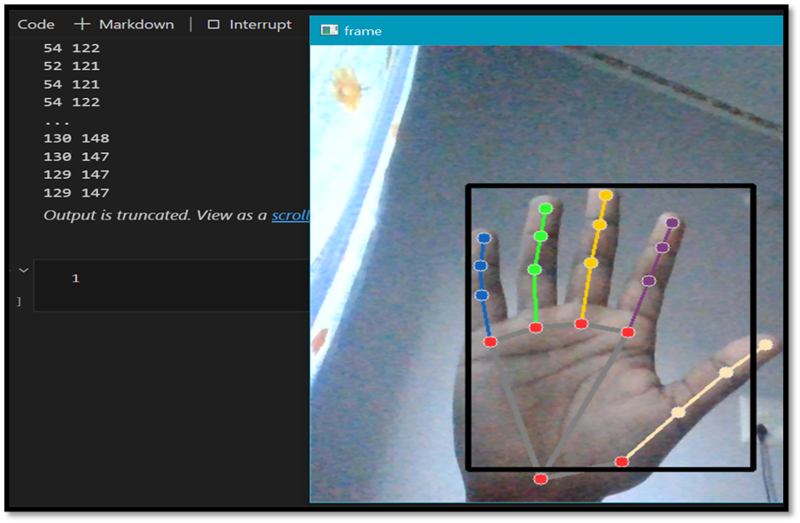
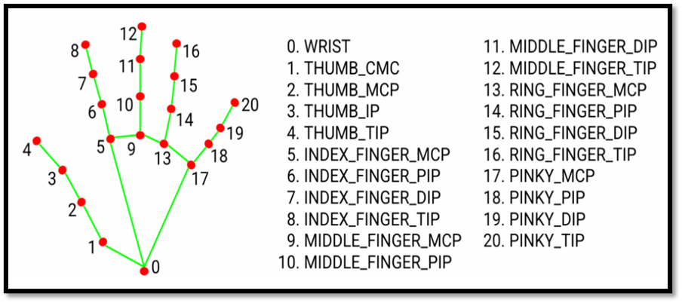
Hand Detection

Slide 12
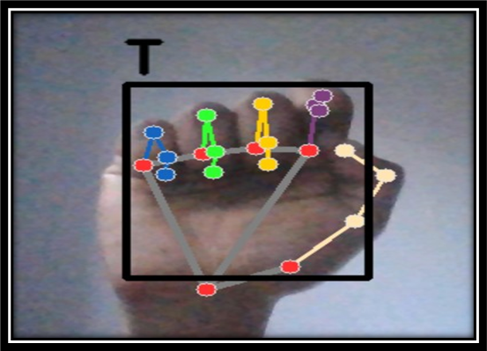
Text Prediction

Slide 13

Suggested Words and Sentences
Based on the predicted character, SignCompanion suggests common words or sentences that a person might want to convey.
This feature makes communication easier for those who may not be familiar with sign language.

Slide 14
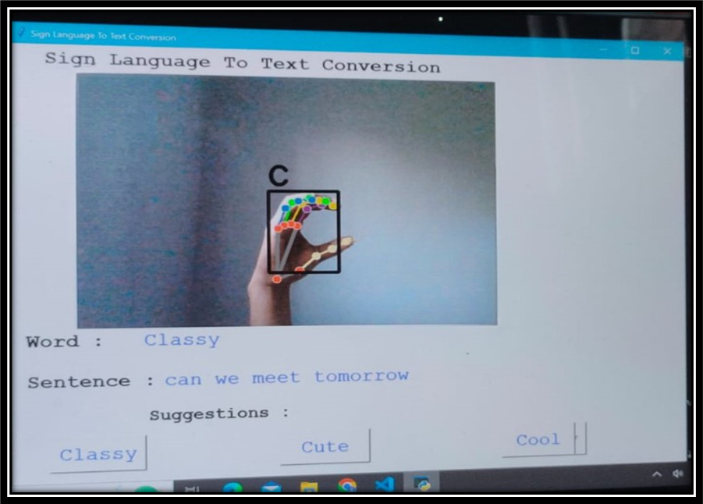
.

Slide 15

Accessibility and Affordability
SignCompanion is an accessible and affordable solution for communication between normal and hearing impaired individuals.
It can eliminates the need for expensive hearing support devices.

Slide 16

Advantages over Traditional Methods
SignCompanion can be more efficient and effective communication method as compared to traditional methods of writing or typing out messages.
It can provide a faster and more accurate communication experience for both parties.

Slide 17
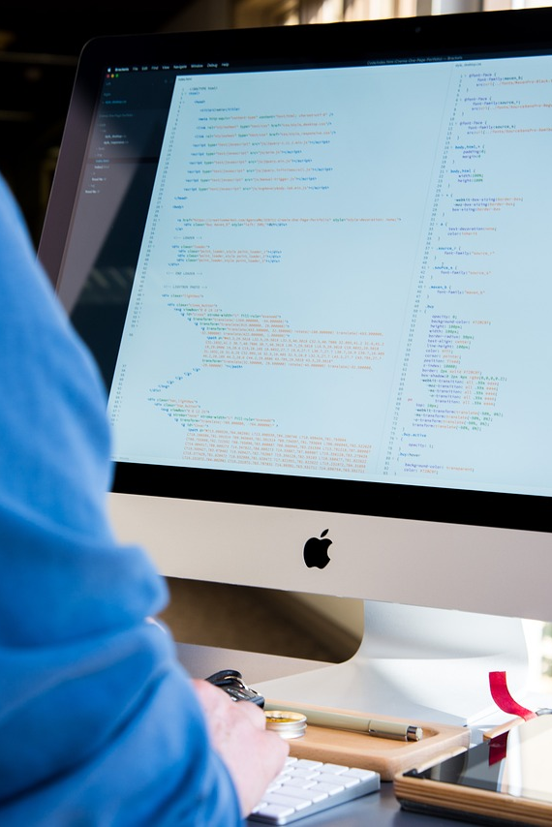
Potential for Further Developments
SignCompanion has the potential for further developments such as incorporating more languages and improving the accuracy of the sign language recognition. Also a model can also be trained using for converting text into sign language videos It can be based on image to text mapping.

Slide 18
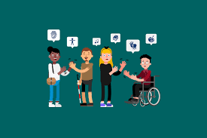
Impact on Society
SignCompanion has a positive impact on society by increasing communication and inclusivity among hearing impaired individuals and normal people.
It provides equal communication opportunities for both parties.
It can help in education sector to increase the participation of hearing impaired wards in school,colleges etc.
With improvement their is no need to hire a translator.

Slide 19

Future of SignCompanion
SignCompanion is promising for the future as it has the potential to transform communication methods for the hearing impaired and make information more accessible.

Slide 20
Thank you for your time 😊

Slide 21
Questions

